Slide 1
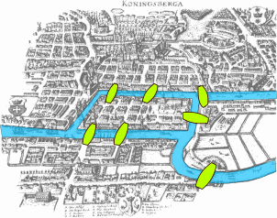
Introduction to Graphs

Slide 2

Tree
Graphs with no cycles?
A forest.
Connected graphs with no cycles?
A tree.

Slide 3
More Trees
leaf
leaf
A leaf is a vertex of degree 1.
More leaves.
Even more leaves.

Slide 4
Tree Characterization by Path
Definition. A tree is a connected graph with no cycles.
Can there be no path between u and v?
NO
Can there be more than one simple path between u and v?
NO
This will create cycles.
u
v
Claim. In a tree, there is a unique simple path between every pair of vertices.

Slide 5
Tree Characterization by Number of Edges
Definition. A tree is a connected graph with no cycles.
Can a tree has no leaves?
NO
How many edges does a tree have?
n-1?
We usually use n to denote the number of vertices,
and use m to denote the number of edges in a graph.

Slide 6
Tree Characterization by Number of Edges
Definition. A tree is a connected graph with no cycles.
Can a tree has no leaves?
NO
How many edges does a tree have?
n-1?
v
Look at a leaf v.
Is T-v a tree?
YES
Can T-v has a cycle?
Is T-v connected?
NO
YES
By induction, T-v has (n-1)-1=n-2 edges.
So T has n-1 edges.

Slide 7
Tree Characterizations
Definition. A tree is a connected graph with no cycles.
Characterization by paths:
A graph is a tree if and only if
there is a unique simple path between every pair of vertices.
Characterization by number of edges:
A graph is a tree if and only if it is connected and has n-1 edges.

Slide 8
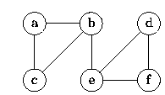
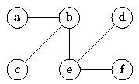
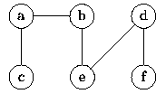
Spanning Tree
In a tree there is always exactly one path from each vertex in the graph to any other vertex in the graph.
A spanning tree for a graph is a subgraph that includes every vertex of the original, and is a tree.
(a) Graph G
(b) Breadth-first spanning tree of G rooted at b
(c) Depth-first spanning tree of G rooted at c
Using the procedure i.e., remove edges from cycles until only a tree remains

Slide 9
Finding a Spanning Tree
Find a spanning tree for the graph below.
We could break the two cycles by removing a single edge from each. One of several possible ways to do this is shown below.
Was breadth-first or depth-first search (or neither) used to create this?
Prove that every connected graph has a spanning tree

Slide 10
Minimum Spanning Tree
A spanning tree that has minimum total weight is called a minimum spanning tree for the graph.
Technically it is a minimum-weight spanning tree.
If all edges have the same weight, breadth-first search or depth-first search will yield minimum spanning trees.
For the rest of this discussion, we assume the edges have weights associated with them.
Note, we are strictly dealing with undirected graphs here, for directed graphs we would want to find the optimum branching or aborescence of the directed graph.

Slide 11
Minimum Spanning Tree
Minimum-cost spanning trees have many applications.
Building cable networks that join n locations with minimum cost.
Building a road network that joins n cities with minimum cost.
Obtaining an independent set of circuit equations for an electrical network.
In pattern recognition minimal spanning trees can be used to find noisy pixels.

Slide 12
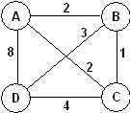
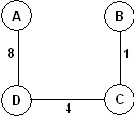
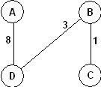
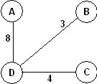
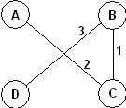
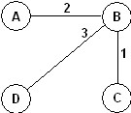
Minimum Spanning Tree
Consider this graph.
It has 20 spanning trees. Some are:
There are two minimum- cost spanning trees, each with a cost of 6:

Slide 13
Minimum Spanning Tree
Brute Force option:
For all possible spanning trees
Calculate the sum of the edge weights
Keep track of the tree with the minimum weight.
Step i) requires N-1 time, since each tree will have exactly N-1 edges.
If there are M spanning trees, then the total cost will O(MN).
Consider a complete graph, with N(N-1) edges. How big can M be?

Slide 14
Brute Force MST
For a complete graph, it has been shown that there are N^{N-2} possible spanning trees!
Alternatively, given N items, you can build N^{N-2} distinct trees to connect these items.

Slide 15
Minimum Spanning Tree
There are many approaches to computing a minimum spanning tree.
We could try to detect cycles and remove edges, but the two algorithms we will study build them from the bottom-up in a greedy fashion.
Kruskal’s Algorithm – starts with a forest of single node trees and then adds the edge with the minimum weight to connect two components.
Prim’s Algorithm – starts with a single vertex and then adds the minimum edge to extend the spanning tree.

Slide 16
Kruskal’s Algorithm
Greedy algorithm to choose the edges as follows.
Step 1 | First edge: choose any edge with the minimum weight.
Step 2 | Next edge: choose any edge with minimum weight from those not yet selected. (The subgraph can look disconnected at this stage.)
Step 3 | Continue to choose edges of minimum weight from those not yet selected, except do not select any edge that creates a cycle in the subgraph.
Step 4 | Repeat step 3 until the subgraph connects all vertices of the original graph.

Slide 17
Kruskal’s Algorithm
Use Kruskal’s algorithm to find a minimum spanning tree for the graph.
1
E
7
D
4.5
A
F
9.5
3
10
7.5
1.5
4
B
C
8

Slide 18
Kruskal’s Algorithm
Solution
First, choose ED (the smallest weight).
1
E
7
D
4.5
A
F
9.5
3
10
7.5
1.5
4
B
C
8

Slide 19
Kruskal’s Algorithm
Solution
Now choose BF (the smallest remaining weight).
1
E
7
D
4.5
A
F
9.5
3
10
7.5
1.5
4
B
C
8

Slide 20
Kruskal’s Algorithm
Solution
Now CD and then BD.
1
E
7
D
4.5
A
F
9.5
3
10
7.5
1.5
4
B
C
8

Slide 21
Kruskal’s Algorithm
Solution
Note EF is the smallest remaining, but that would create a cycle. Choose AE and we are done.
1
E
7
D
4.5
A
F
9.5
3
10
7.5
1.5
4
B
C
8

Slide 22
Kruskal’s Algorithm
Solution
The total weight of the tree is 16.5.
1
E
7
D
4.5
A
F
9.5
3
10
7.5
1.5
4
B
C
8

Slide 23
Kruskal’s Algorithm
Some questions:
How do we know we are finished?
How do we check for cycles?
1
E
7
D
4.5
A
F
9.5
3
10
7.5
1.5
4
B
C
8

Slide 24
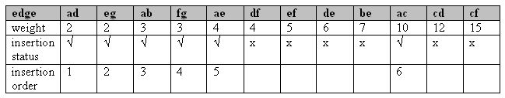
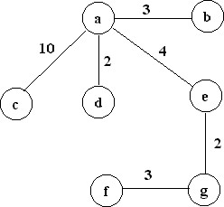
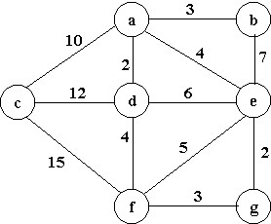
Kruskal’s Algorithm
Trace of Kruskal's algorithm for the undirected, weighted graph:
The minimum cost is: 24

Slide 25
Kruskal’s Algorithm
2
19
9
14
17
8
25
5
21
13
1

Slide 26
Kruskal’s Algorithm
2
19
9
14
17
8
25
5
21
13
1?
1

Slide 27
Kruskal’s Algorithm
2
19
9
14
17
8
25
5
21
13
1?
1

Slide 28
Kruskal’s Algorithm
2
19
9
14
17
8
25
5
21
13
1?
1

Slide 29
Kruskal’s Algorithm
2
19
9
14
17
8
25
5
21
13
1?
1

Slide 30
Kruskal’s Algorithm
2
19
9
14
17
8
25
5
21
13
1?
1

Slide 31
Kruskal’s Algorithm
2
19
9
14
17
8
25
5
21
13
1?
1

Slide 32
Kruskal’s Algorithm
2
19
9
14
17
8
25
5
21
13
1?
1

Slide 33
Prim’s Algorithm
Prim’s algorithm finds a minimum cost spanning tree by selecting edges from the graph one-by-one as follows:
It starts with a tree, T, consisting of a single starting vertex, x.
Then, it finds the shortest edge emanating from x that connects T to the rest of the graph (i.e., a vertex not in the tree T).
It adds this edge and the new vertex to the tree T.
It then picks the shortest edge emanating from the revised tree T that also connects T to the rest of the graph and repeats the process.

Slide 34
Prim’s Algorithm Abstract
Consider a graph G=(V, E);
Let T be a tree consisting of only the starting vertex x;
while (T has fewer than I V I vertices)
{
find a smallest edge connecting T to G-T;
add it to T;
}

Slide 35
Prim’s Algorithm
2
19
9
14
17
Start here
8
25
5
21
13
1

Slide 36
Prim’s Algorithm
2
19
9
14
17
8
25
5
21
13
1?
1

Slide 37
Prim’s Algorithm
2
19
9
14
17
8
25
5
21
13
1

Slide 38
Prim’s Algorithm
2
19
9
14
17
8
25
5
21
13
1

Slide 39
Prim’s Algorithm
2
19
9
14
17
8
25
5
21
13
1

Slide 40
Prim’s Algorithm
2
19
9
14
17
8
25
5
21
13
1

Slide 41
Prim’s Algorithm
2
19
9
14
17
8
25
5
21
13
1

Slide 42
Prim’s Algorithm
2
19
9
14
17
8
25
5
21
13
1

Slide 43
Prim’s and Kruskal’s Algorithms
It is not necessary that Prim's and Kruskal's algorithm generate the same minimum-cost spanning tree.
For example for the graph shown on the right:
Kruskal's algorithm results in the following minimum cost spanning tree:
The same tree is generated by Prim's algorithm if the start vertex is any of: A, B, or D.
However if the start vertex is C the minimum cost spanning tree generated by Prim’s algorithm is:

Slide 44
Kruskal vs. Prim
Both are Greedy algorithms
Both take the next minimum edge
Both are optimal (find the global min)
Different sets of edges considered
Kruskal – all edges
Prim – Edges from Tree nodes to rest of G.
Both need to check for cycles
Kruskal – set containment and union.
Prim – Simple boolean.
Both can terminate early
Kruskal – when |V|-1 edges are added.
Prim – when |V| nodes are added (or |V|-1 edges).
Both are O( |E| log|V| )
Prim can be O( |E| + |V| log|V| ) w/ Fibonacci Heaps
Prim with an adjacency matrix is O(|V|²).

Slide 45
Eulerian Graphs

Slide 46
Definition

Slide 47
Denition : Let G be a graph. Then, G is said to have an Eulerian tour if there is a closed walk, say [v0; v1; : : : ; vk; v0], such that each edge of the graph appears exactly once in the walk.
The graph G is said to be Eulerian if it has an Eulerian tour.
Is there a way to start from a land mass to that passes through all the seven bridges and return back to the starting land mass
Euler, rephrased the problem : Let the four land masses be denoted by the vertices A;B;C and D of a graph and let the 7 bridges correspond to 7 edges of the graph.

Slide 48
Eulerian Graphs
Euler’s theorem: A graph has an Eulerian path if and only if it is
connected and has at most two vertices with an odd number of edges.
Can a graph have only 1
odd degree vertex?
Odd degree vertices.
An Eulerian path is a path that uses every edge of a graph exactly once
Euler’s theorem: A graph has an Eulerian path if and only if
it has zero or two vertices with odd degrees.
Proof by induction.

Slide 49
Eulerian Cycle
Euler’s theorem: A connected graph has an Eulerian cycle if and only if
every vertex is of even degree.
First we find an Eulerian cycle in the below example.
An Eulerian trail is a trail in a finite graph that visits every edge exactly once.
Similarly, an Eulerian circuit or Eulerian cycle is an Eulerian trail that starts and ends on the same vertex

Slide 50
Eulerian Cycle
Euler’s theorem: A connected graph has an Eulerian cycle if and only if
every vertex is of even degree.
Note that the edges can be partitioned into five simple cycles.
Vertices of the same color represent the same vertices.

Slide 51
Eulerian Cycle
Euler’s theorem: A connected graph has an Eulerian cycle if and only if
every vertex is of even degree.
The idea is that we can construct an Eulerian cycle by adding cycle one by one.
1
2
First transverse the first cycle.

Slide 52
Eulerian Cycle
Euler’s theorem: A connected graph has an Eulerian cycle if and only if
every vertex is of even degree.
The idea is that we can construct an Eulerian cycle by adding cycle one by one.
1
6
2
3
5
4
Then transverse the second cycle.

Slide 53
Eulerian Cycle
Euler’s theorem: A connected graph has an Eulerian cycle if and only if
every vertex is of even degree.
How to deal with the third cycle?
9
1
10
2
6
8
3
5
7
4
We can “detour” to the third cycle before finishing the second cycle.

Slide 54
Eulerian Cycle
Euler’s theorem: A connected graph has an Eulerian cycle if and only if
every vertex is of even degree.
We use the same idea to deal with the fourth cycle
13
1
14
10
2
6
12
3
5
11
9
7
4
8
We can “detour” to the fourth cycle at an “intersection point”.

Slide 55
Eulerian Cycle
Euler’s theorem: A connected graph has an Eulerian cycle if and only if
every vertex is of even degree.
15
16
12
13
1
14
10
9
14
2
6
12
10
3
5
11
9
13
11
7
4
8
We can “insert” the fifth cycle at an “intersection point”.

Slide 56
Eulerian Cycle
Euler’s theorem: A connected graph has an Eulerian cycle if and only if
every vertex is of even degree.
15
1
16
12
9
2
6
14
10
3
5
13
11
7
4
8
So we have an Eulerian cycle of this example

Slide 57
Idea
In general, if we have a “partial” Eulerian cycle C*,
and it intersects with a cycle C on a vertex v,
then we can extend the Eulerian cycle C* to include C.
C*
C
v
First follow C* until we visit v, then follow C until we go back to v,
and then follow C* from v to the end.

